Slide 1


School of Engineering Technology and Applied Science
API Engineering
Reza Dibaj

Slide 2
AWS Elastic Beanstalk
Watch This

Slide 3
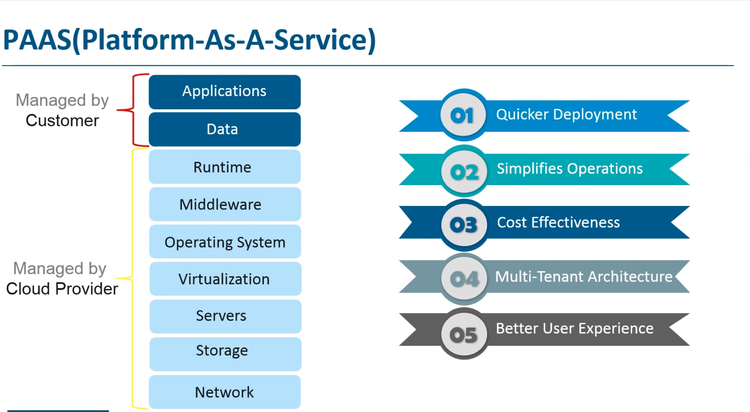

Slide 4
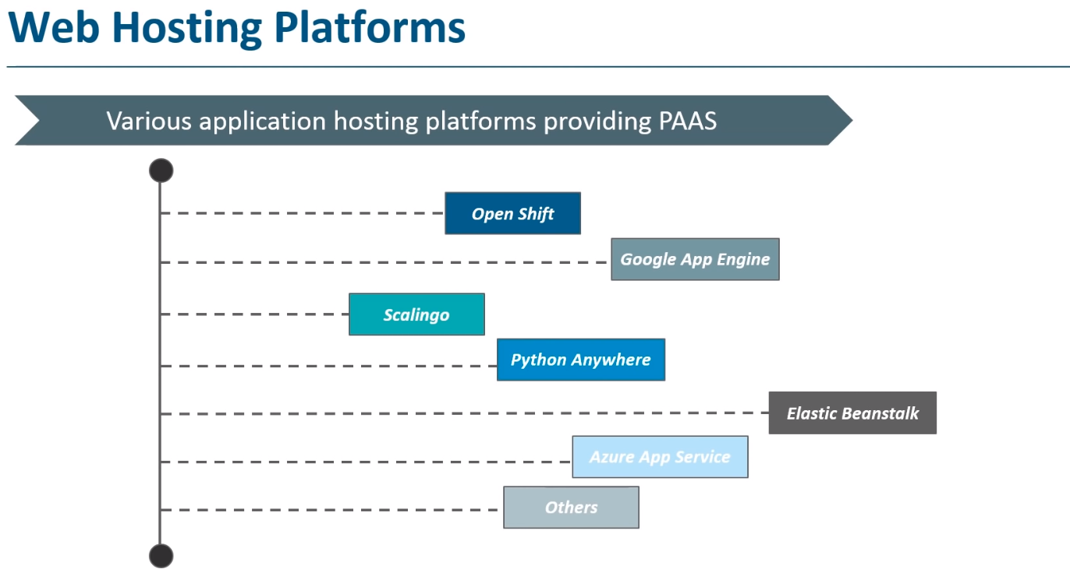

Slide 5
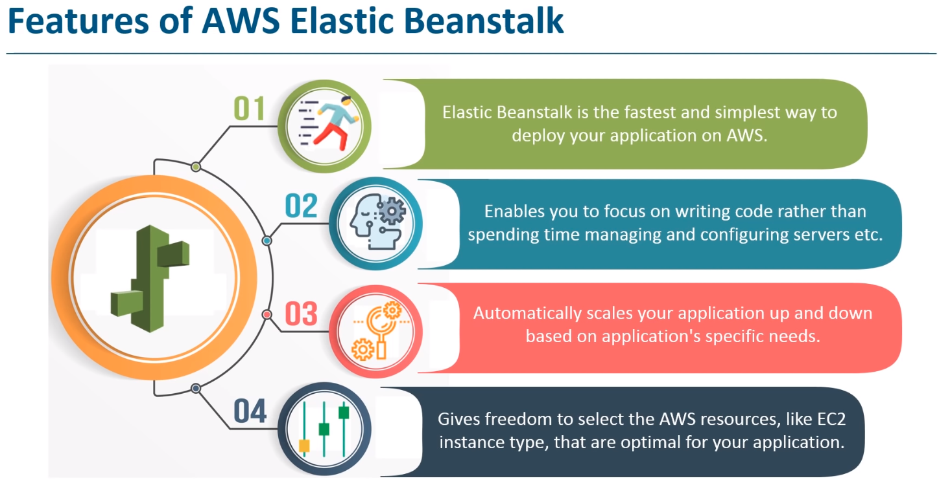

Slide 6
AWS Elastic Beanstalk
AWS Elastic Beanstalk(EB) is a Platform-as-a-Service for deploying, scaling, and managing web applications and services
EB supports web application developed in Java, PHP, .NET, Node.js, Python, Ruby and Go
In terms of Web server EB supports
Apache
Nginx here
recommend to be used on Linux
Passenger here
runs and manages Ruby, Node.js and Python apps
IIS
Notes:
Amazon uses its own DNS, called 53

Slide 7
Elastic Beanstalk Components
Application
A logic collection of Elastic Beanstalk components, including environment, versions, and environment configuration
Application version
Refers to a specific source code version for web app. App version is part of an app. Each app can have multiple versions
Environment
Web server environment (aka Web server ties)
Worker environment(aka worker tier)
Environment configuration
Defines how an environment and its associated resources will behave
Configuration template
A starting point for creating unique environment configurations which can be created or modified using CLI or API
Notes:
Worker env for doing stuff in the bg – time consuming tasks, etc.
Web server env for RT tasks – streaming, etc.

Slide 8
Environment Tier
AWS Elastic Beanstalk has two types of environment tiers to support different types of web applications
Web servers are standard applications that listen for and then process HTTP request, typically over port 80.
Workers environment are specialized applications that have a background processing task that listens for messages on a n Amazon SQS queue. Worker applications post those messages to your application by using HTTP.

Slide 9
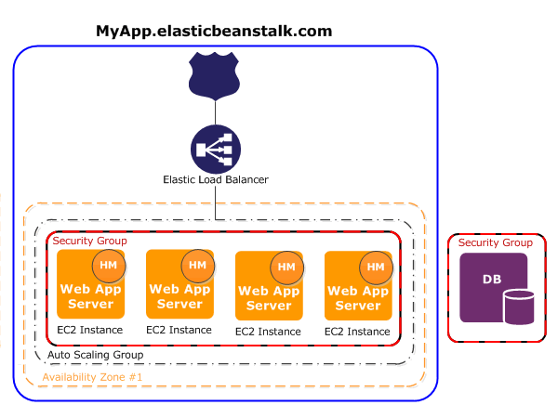
Web Server Tier
The environment is delineated by the solid blue line
When you create an environment, Elastic Beanstalk provisions the resources (i.e., one elastic load balancer, an auto scaling group, and one or more EC2 instance) required to run the application.
A security group acts as a virtual firewall that controls the traffic for one or more instances

Slide 10
Work Environment Tier
If your app performs operations or workflows that take a long time to complete, you can offload those tasks to a dedicated worker environment
A long-running task is anything that substantially increases the time it takes to complete a request (E.g., processing images or videos, sending email, or generating a ZIP archive) These operations can take only a second or two to complete, but these delay is a lot for a web request that would normally complete in less than 500 ms.
Notes:
Not super flexible, just two classes to define for QoS
Might be improved later

Slide 11
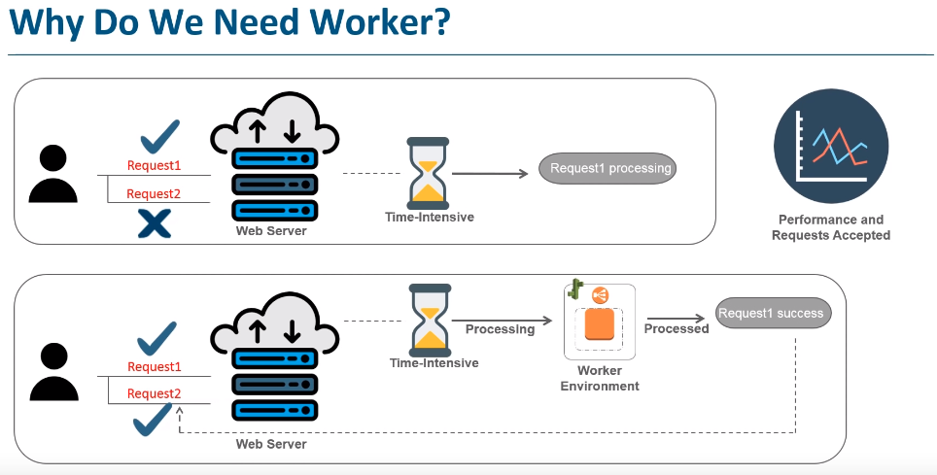

Slide 12
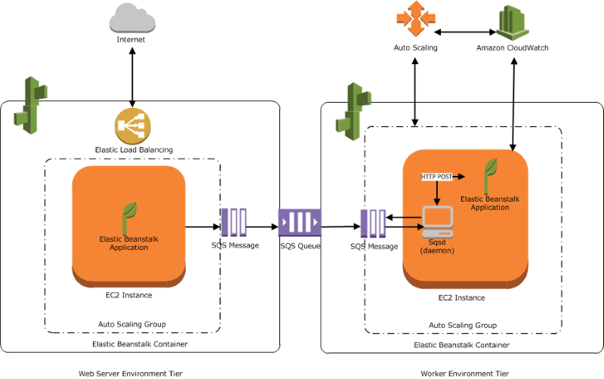
Work Environment Tier
Notes:
Simple queue services is SQS

Slide 13
AWS Simple Queue Service(SQS)
SQS is a fully managed message queuing service that makes it easy to decouple and scale microservices, distributed systems, and serverless applications
Amazon SQS moves data between distributed application components and helps you decouple these components.

Slide 14
Amazon Route 53
It is a highly available and scalable cloud Domain Name System (DNS) web service
It is designed to give developers and businesses an extremely reliable and cost effective way to route end users to Internet applications by translating names like www.example.com into IP
It is fully compliant with IPv6
It effectively connects user requests to infrastructure running in AWS – such as Amazon EC2 instances, Elastic Load Balancing load balancers, or Amazon S3 buckets – and can also be used to route users to infrastructure outside of AWS
Notes:
What internet protocol version is the latest now? It is two digits, used by IoT?
Reza said to find this out

Slide 15
Amazon CloudFront
Amazon CloudFront is a web service that speeds up distribution of the static and dynamic web content, such as .html, and image files, to the users.
CloudFront delivers the content through a worldwide network of data centers called edge locations .
AWS Edge location is the place where the data’s are cached to reduce the latency to the end users. They are located in the major cities around the world . These infrastructure are used to provide only the services such as cloundfront, lambda, etc.
Notes:
Similar to CDN, put the relevant information close to the specific region
Microsoft whiteboard – use it with team to share whiteboard
Microsoft teams

Slide 16
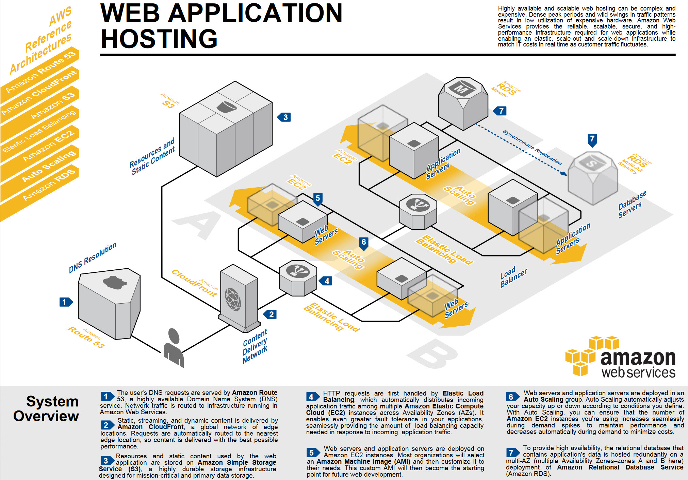
Notes:
Like CDN caching things in diff areas

Slide 17
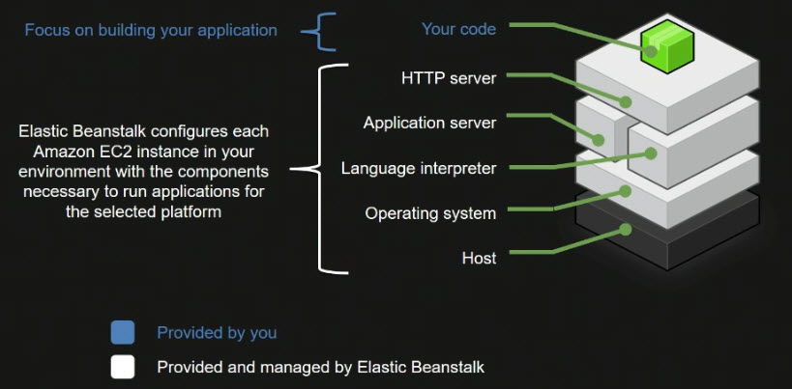
On-Instance Configuration

Slide 18
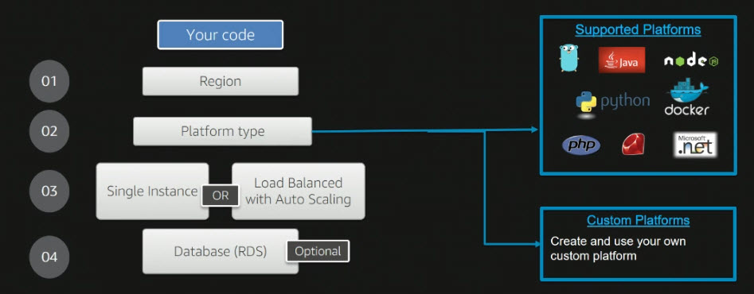
Information Required to Deploy Apps

Slide 19
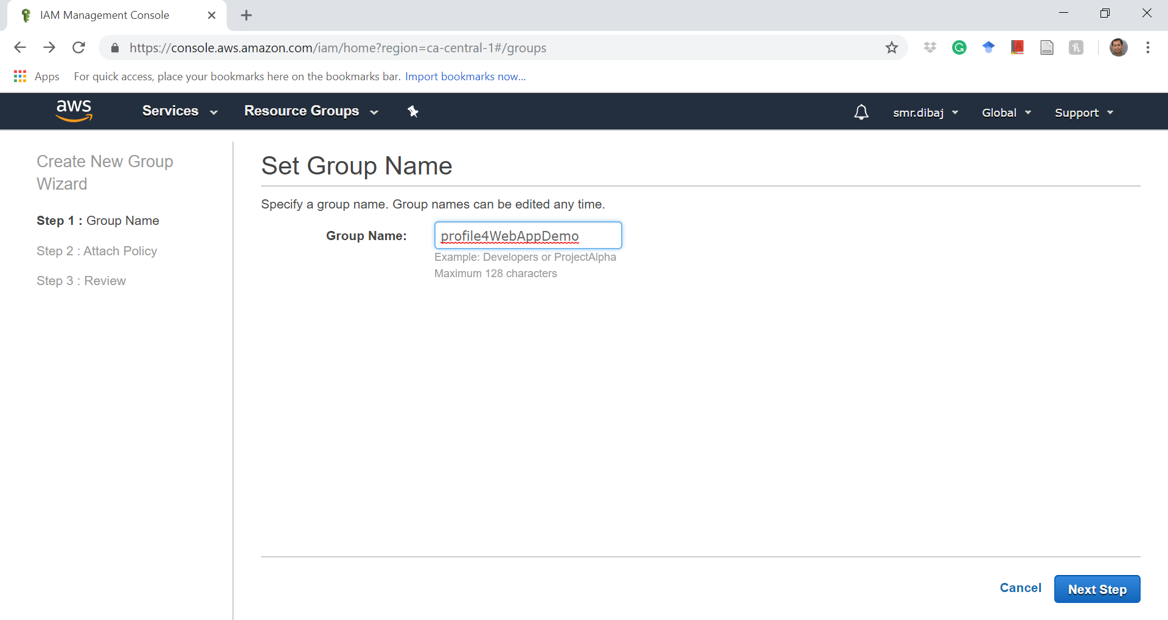
IAM

Slide 20
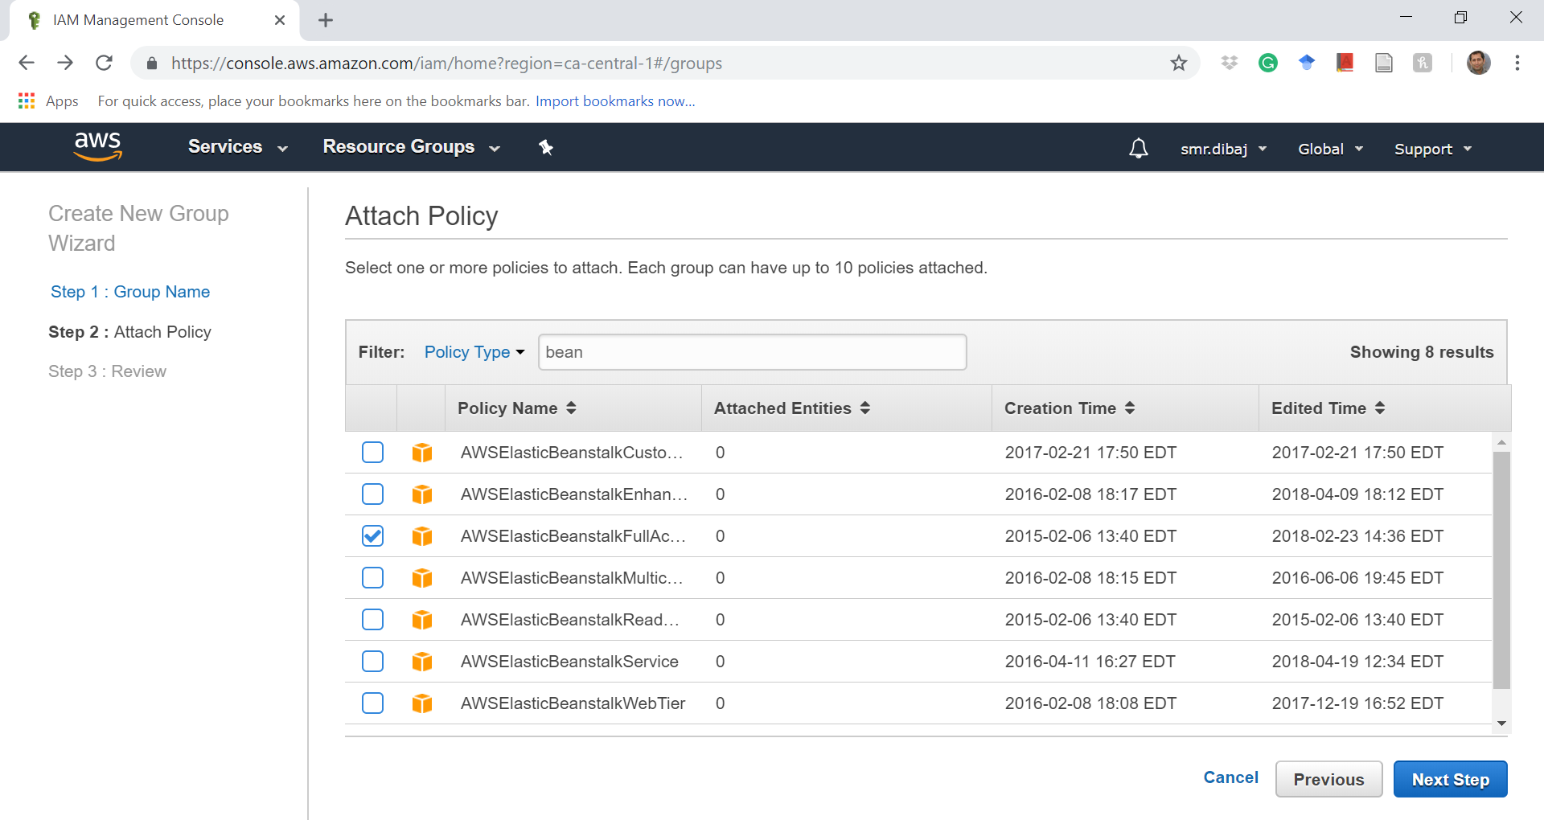
IAM

Slide 21
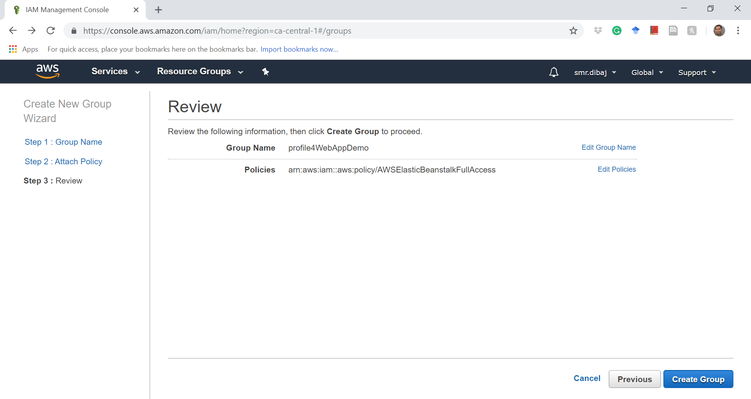
IAM

Slide 22
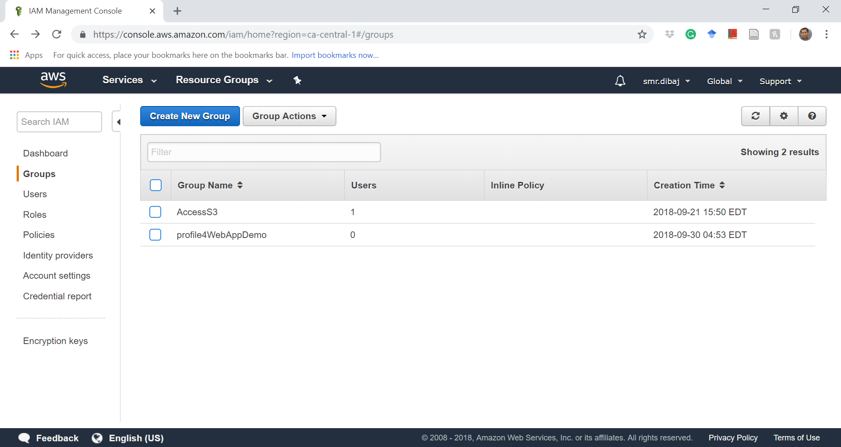
IAM

Slide 23
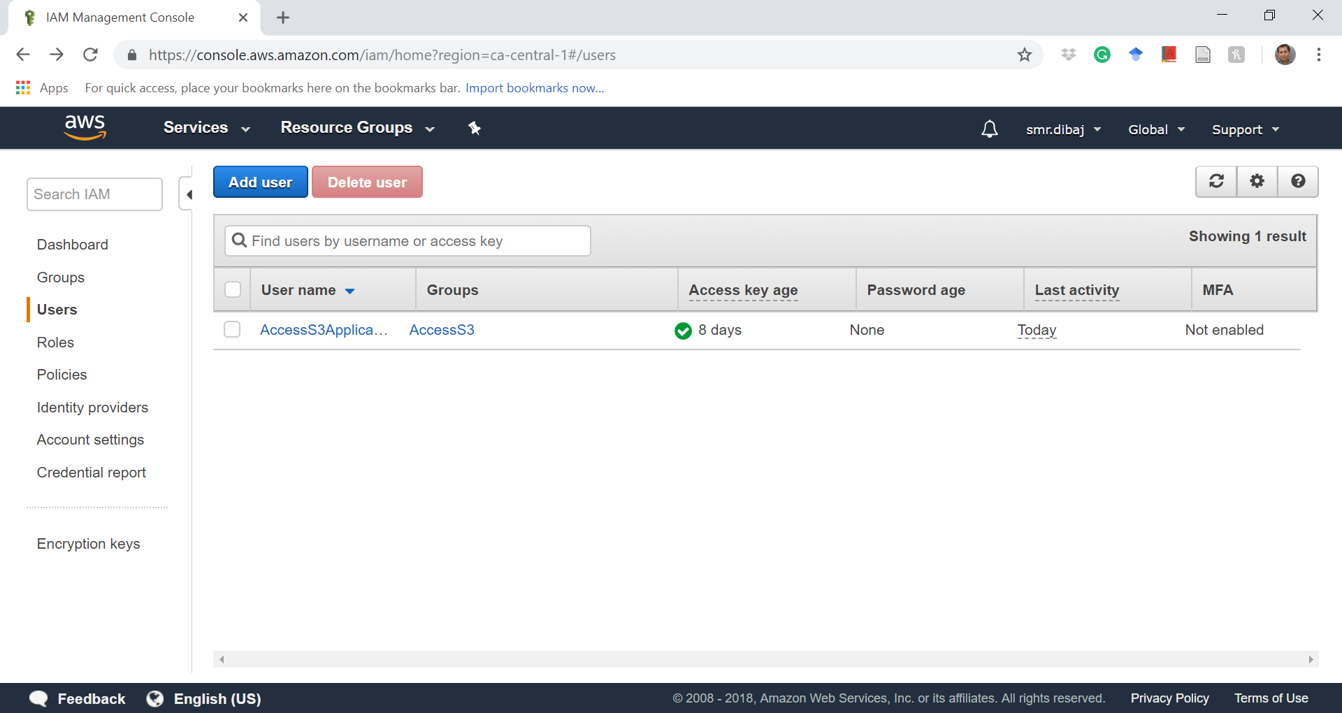
IAM

Slide 24
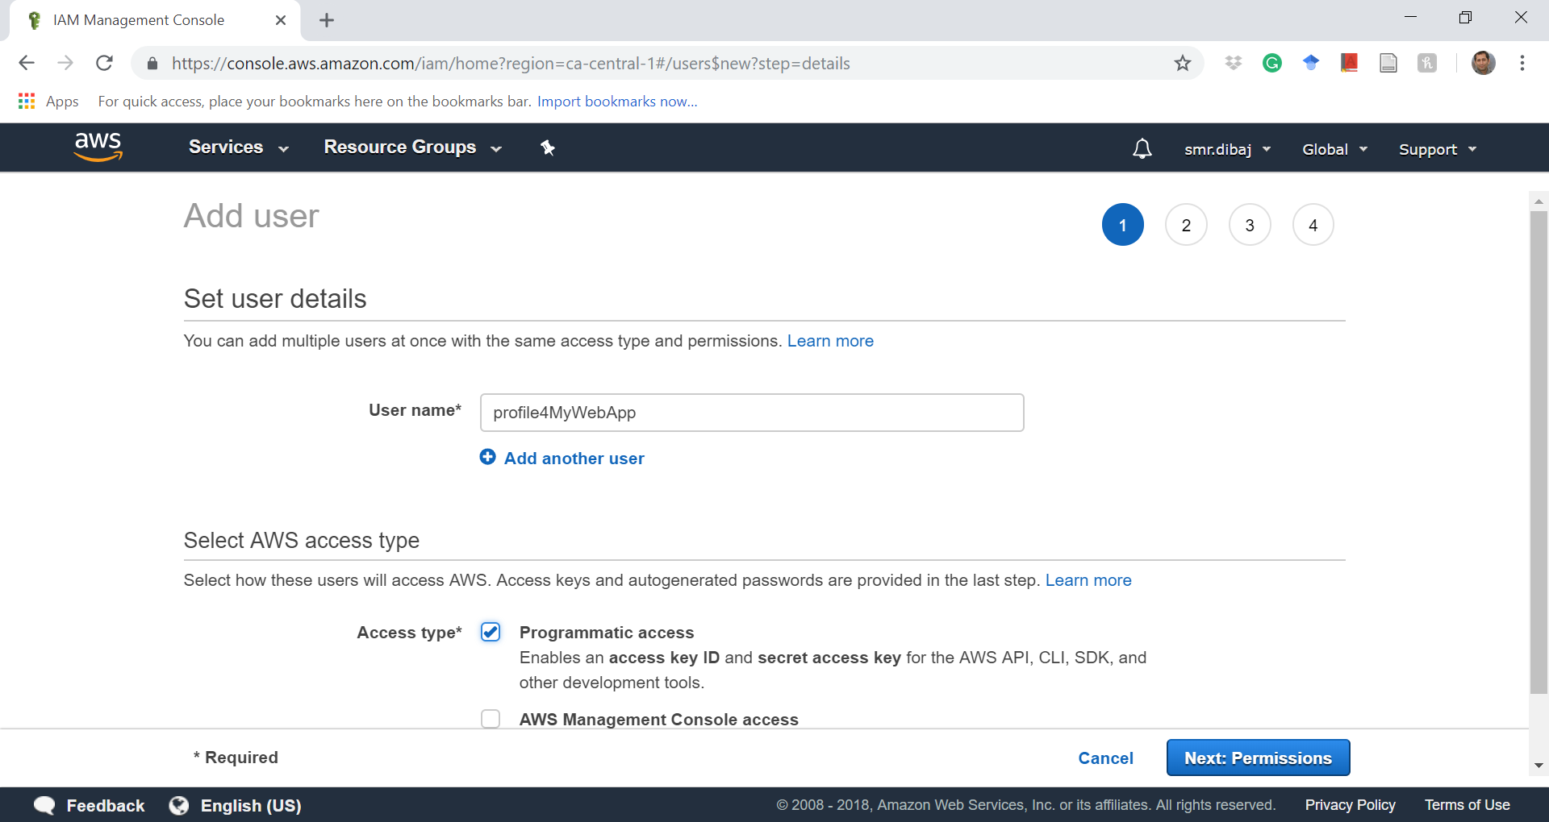
IAM

Slide 25
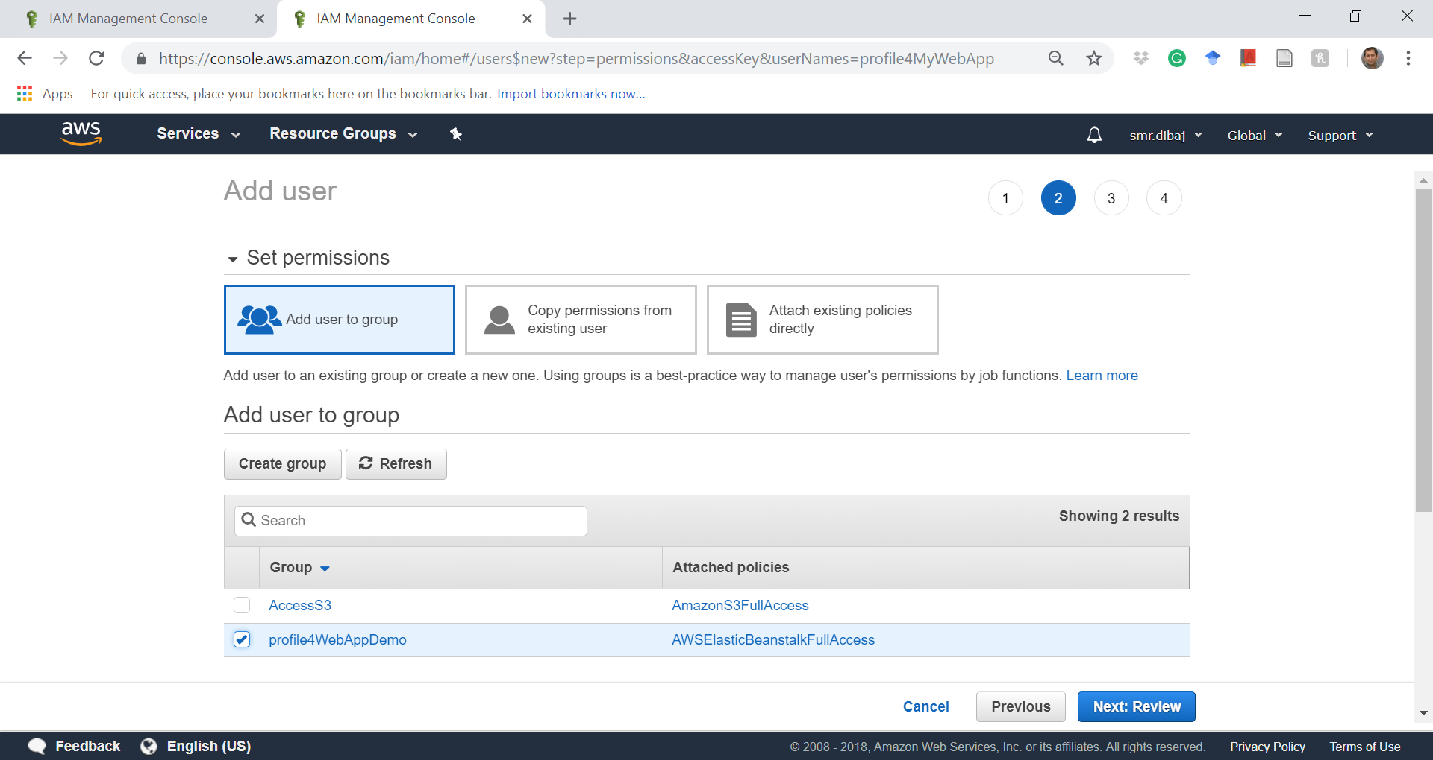
IAM

Slide 26
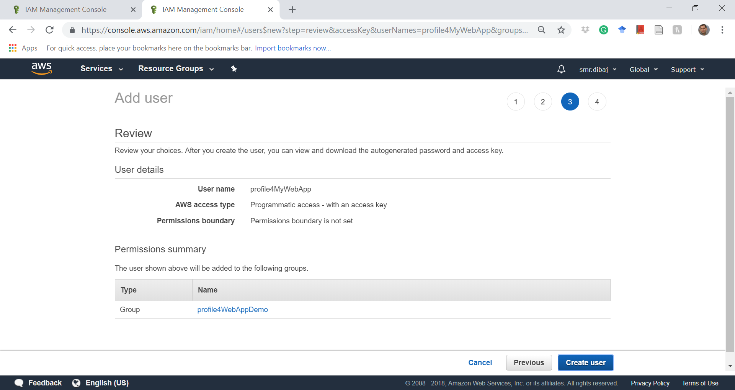
IAM

Slide 27
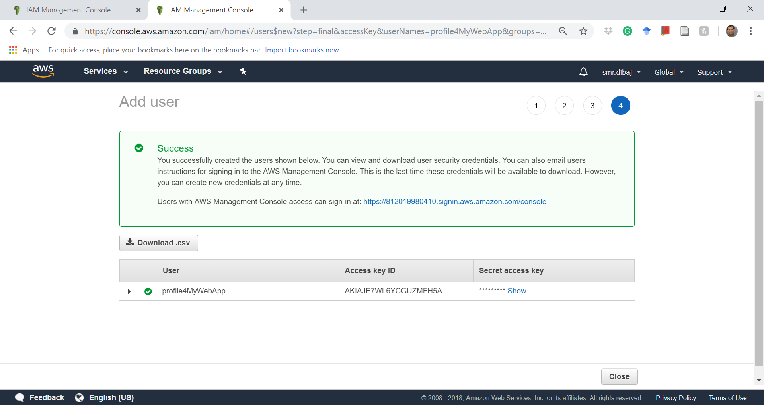
IAM

Slide 28
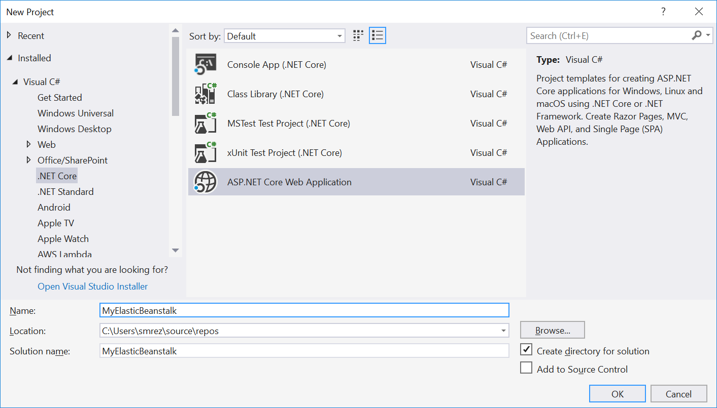
Develop a ASP.NET core Web App%

Slide 29
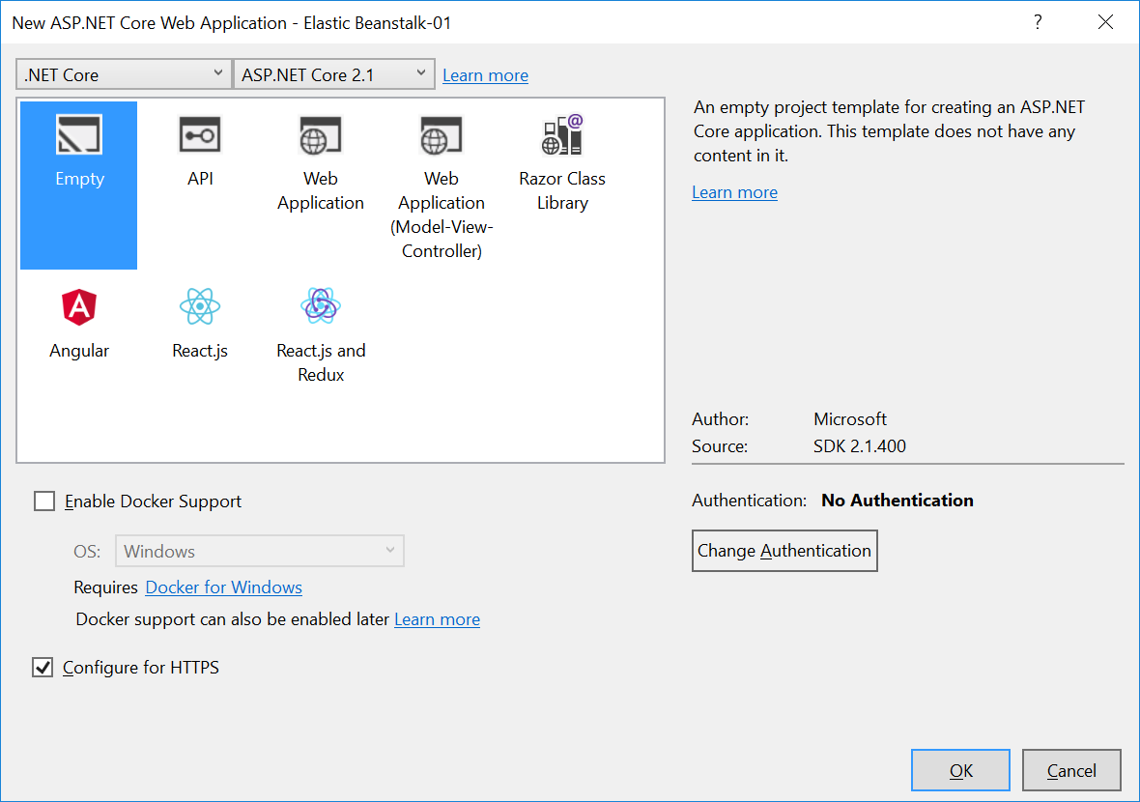
Develop a ASP.NET core Web App%

Slide 30
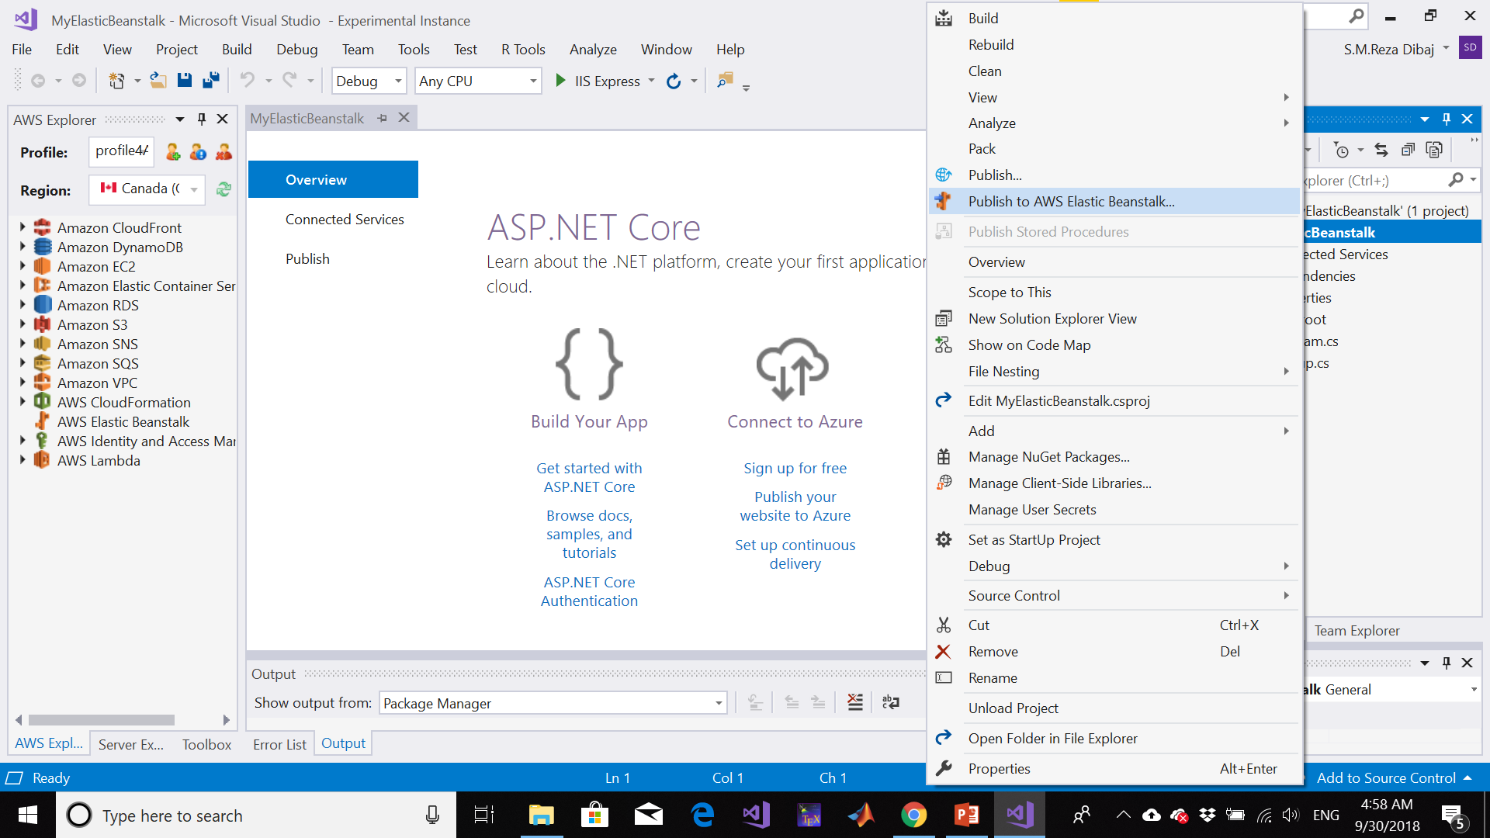
Deploy Web App to AWS Elastic Beanstalk

Slide 31
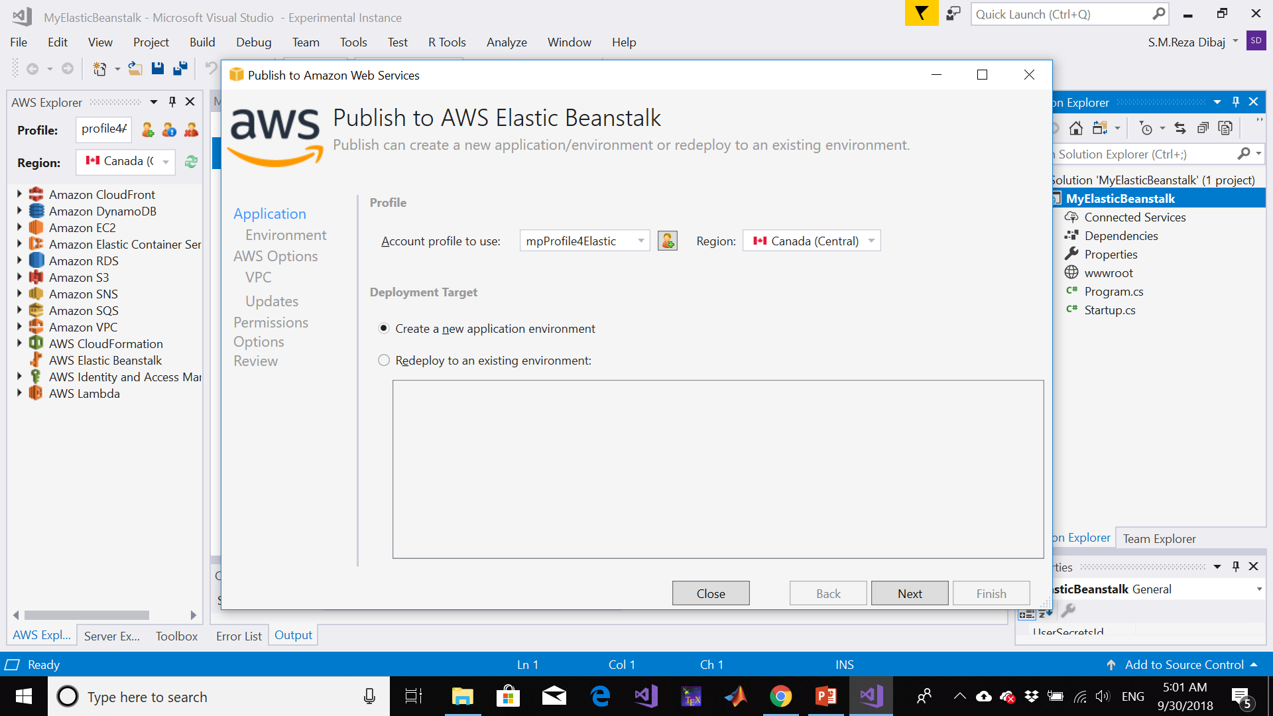
Deploy Web App to AWS Elastic Beanstalk

Slide 32
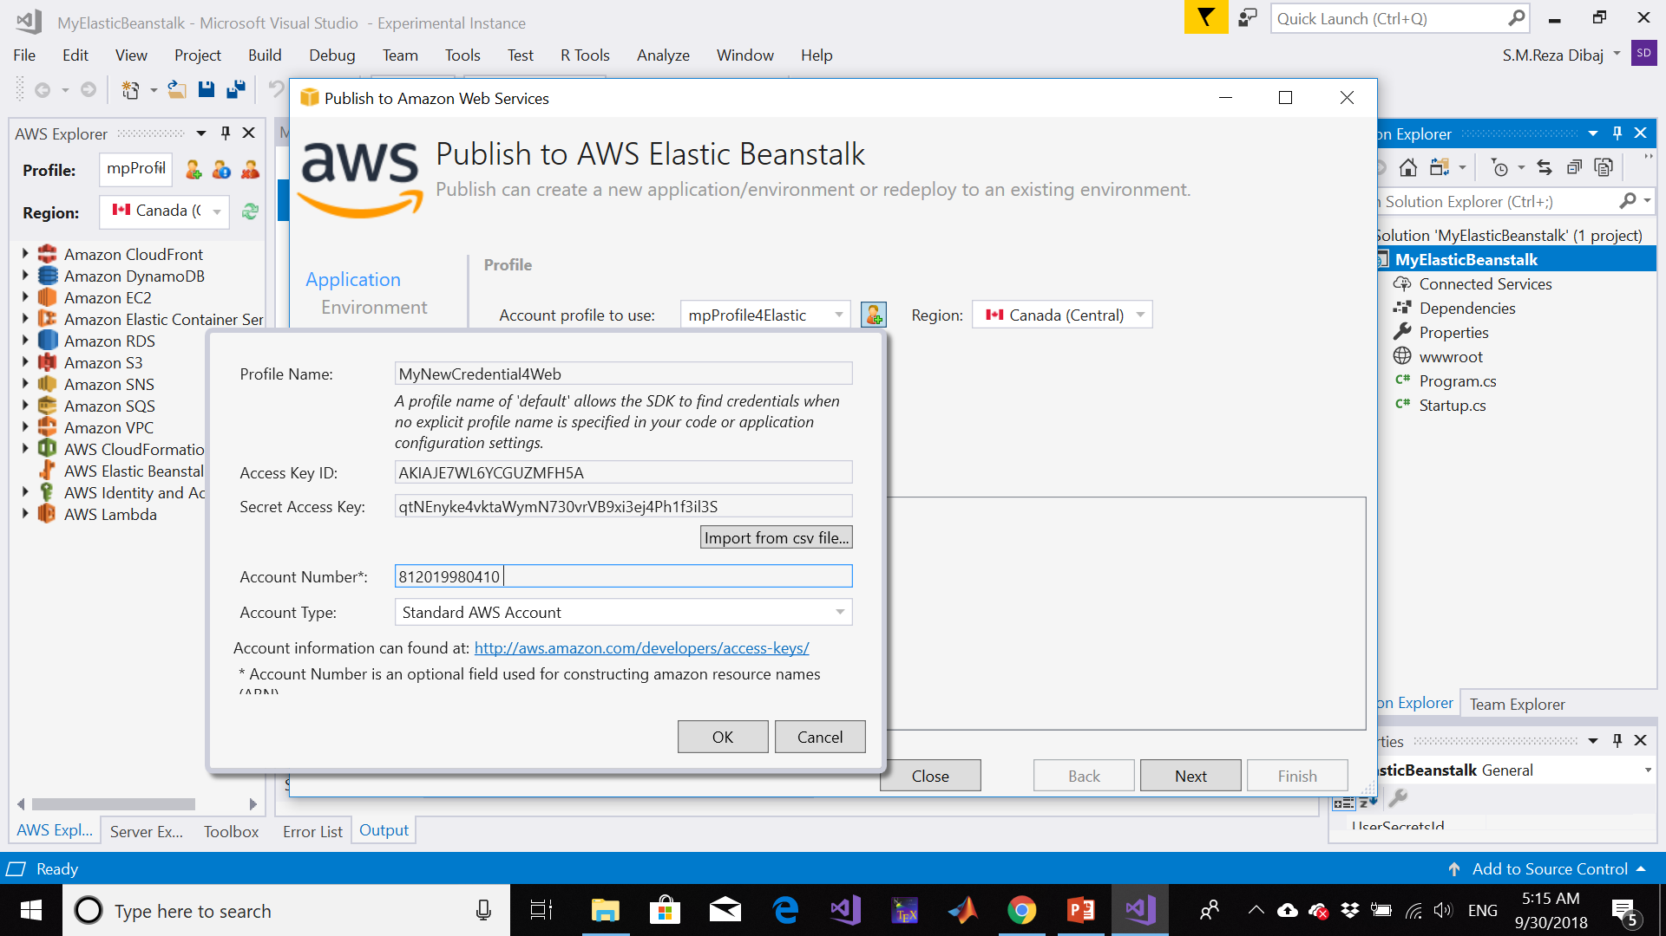
Deploy Web App to AWS Elastic Beanstalk

Slide 33
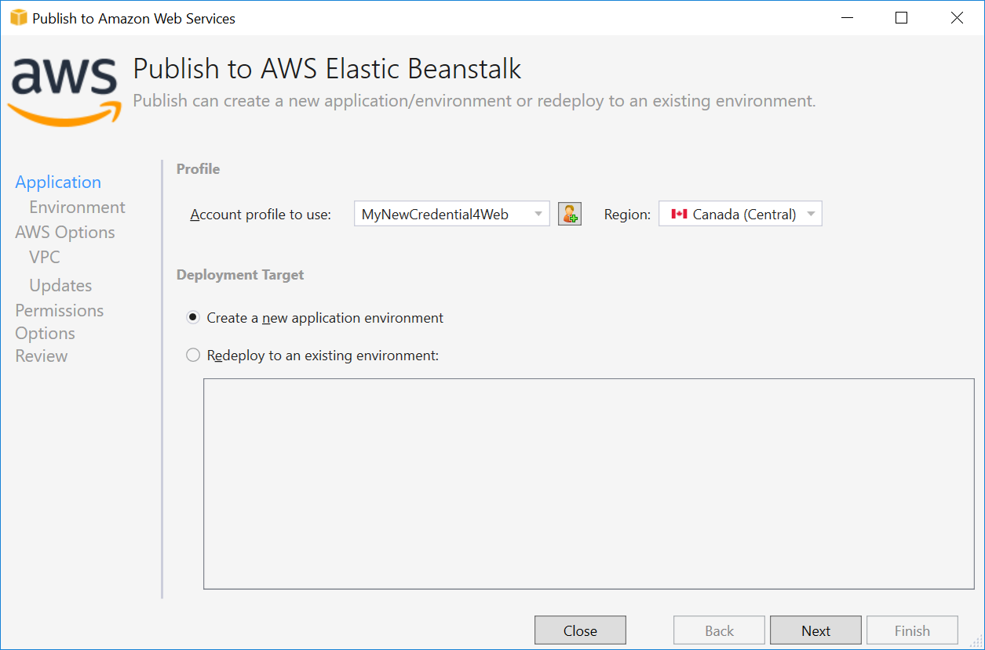
Deploy Web App to AWS Elastic Beanstalk

Slide 34
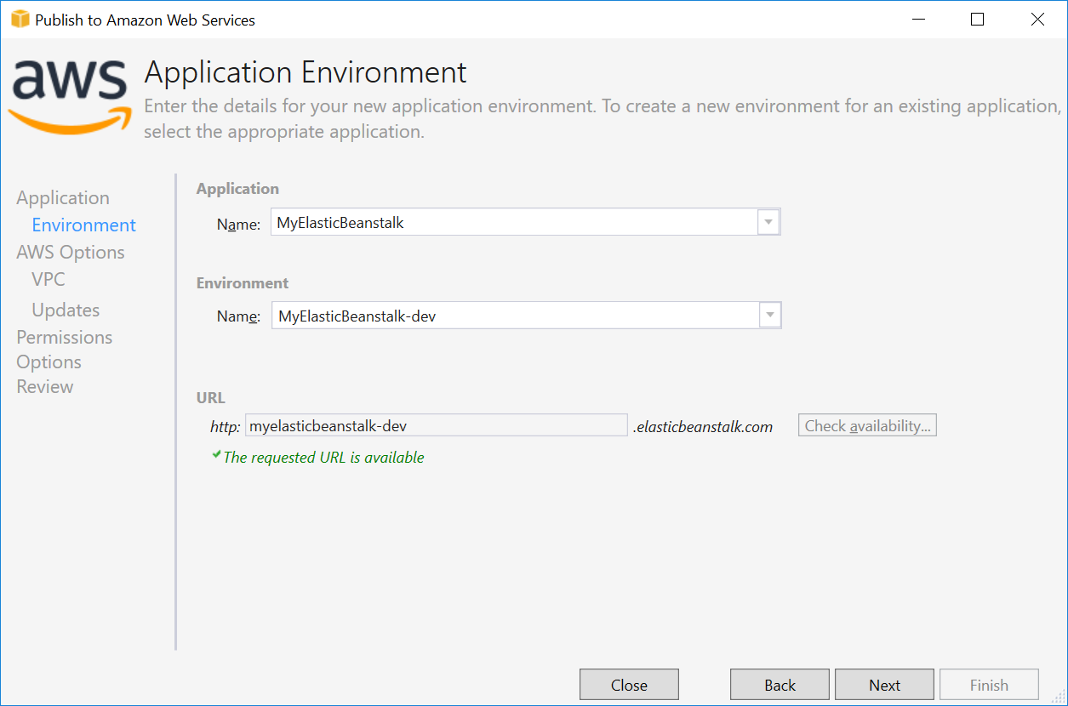
Deploy Web App to AWS Elastic Beanstalk
Notes:
If error in the URL section:
https://www.c-sharpcorner.com/article/deploying-a-web-application-to-aws/

Slide 35
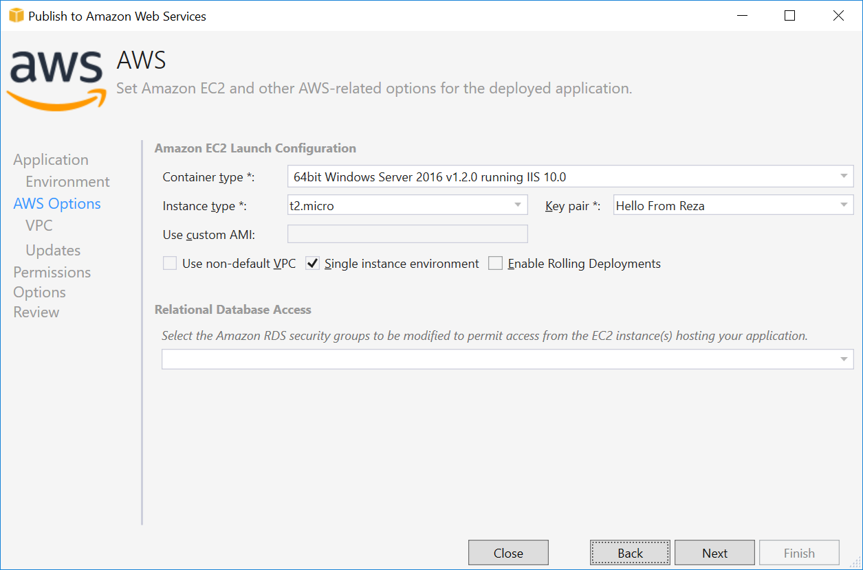
Deploy Web App to AWS Elastic Beanstalk

Slide 36
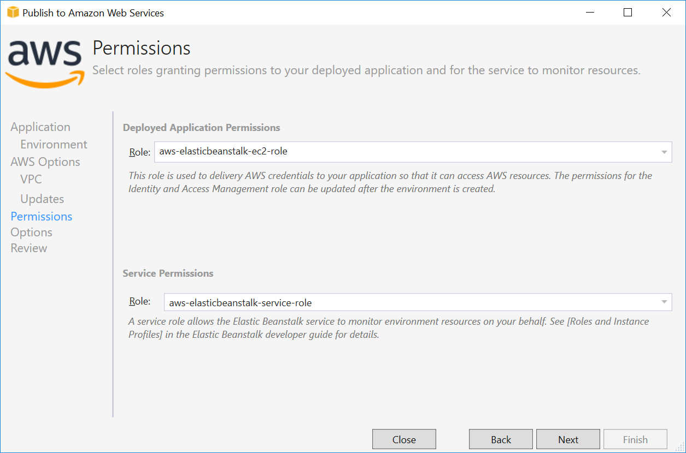
Deploy Web App to AWS Elastic Beanstalk

Slide 37
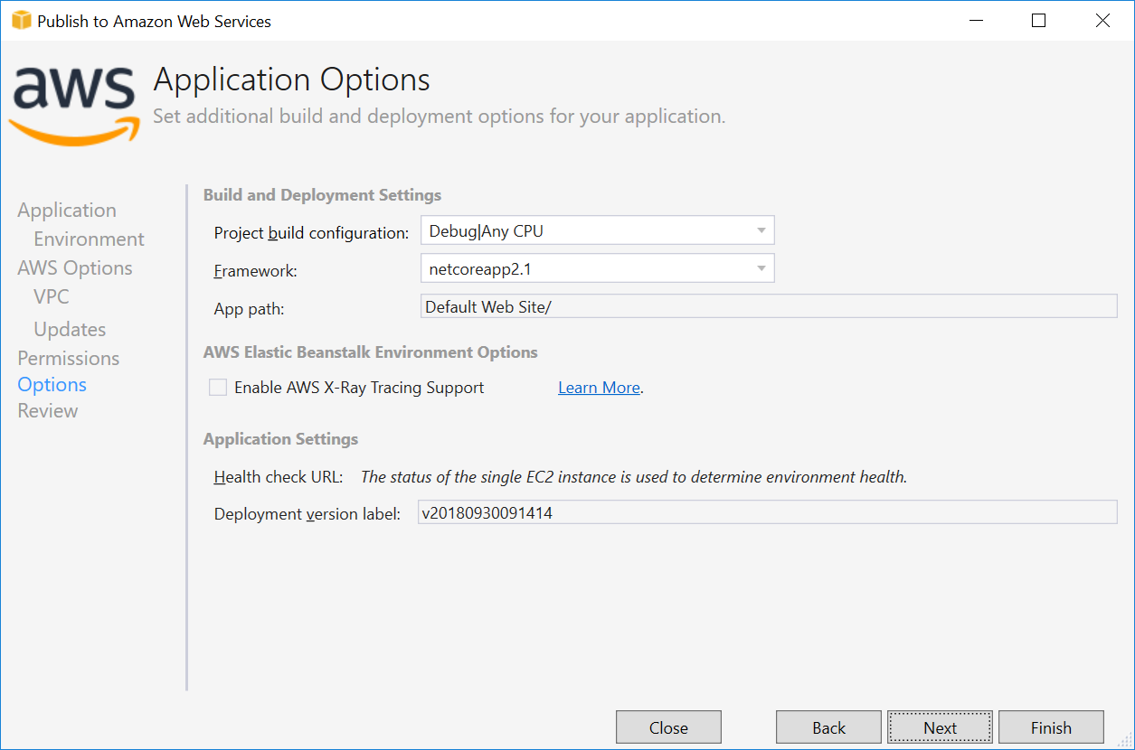
Deploy Web App to AWS Elastic Beanstalk

Slide 38
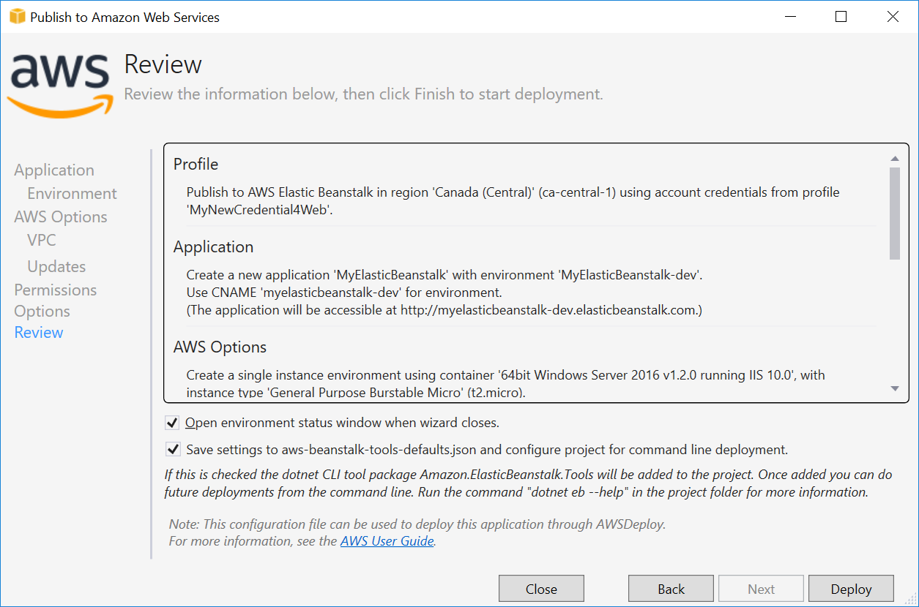
Deploy Web App to AWS Elastic Beanstalk

Slide 39
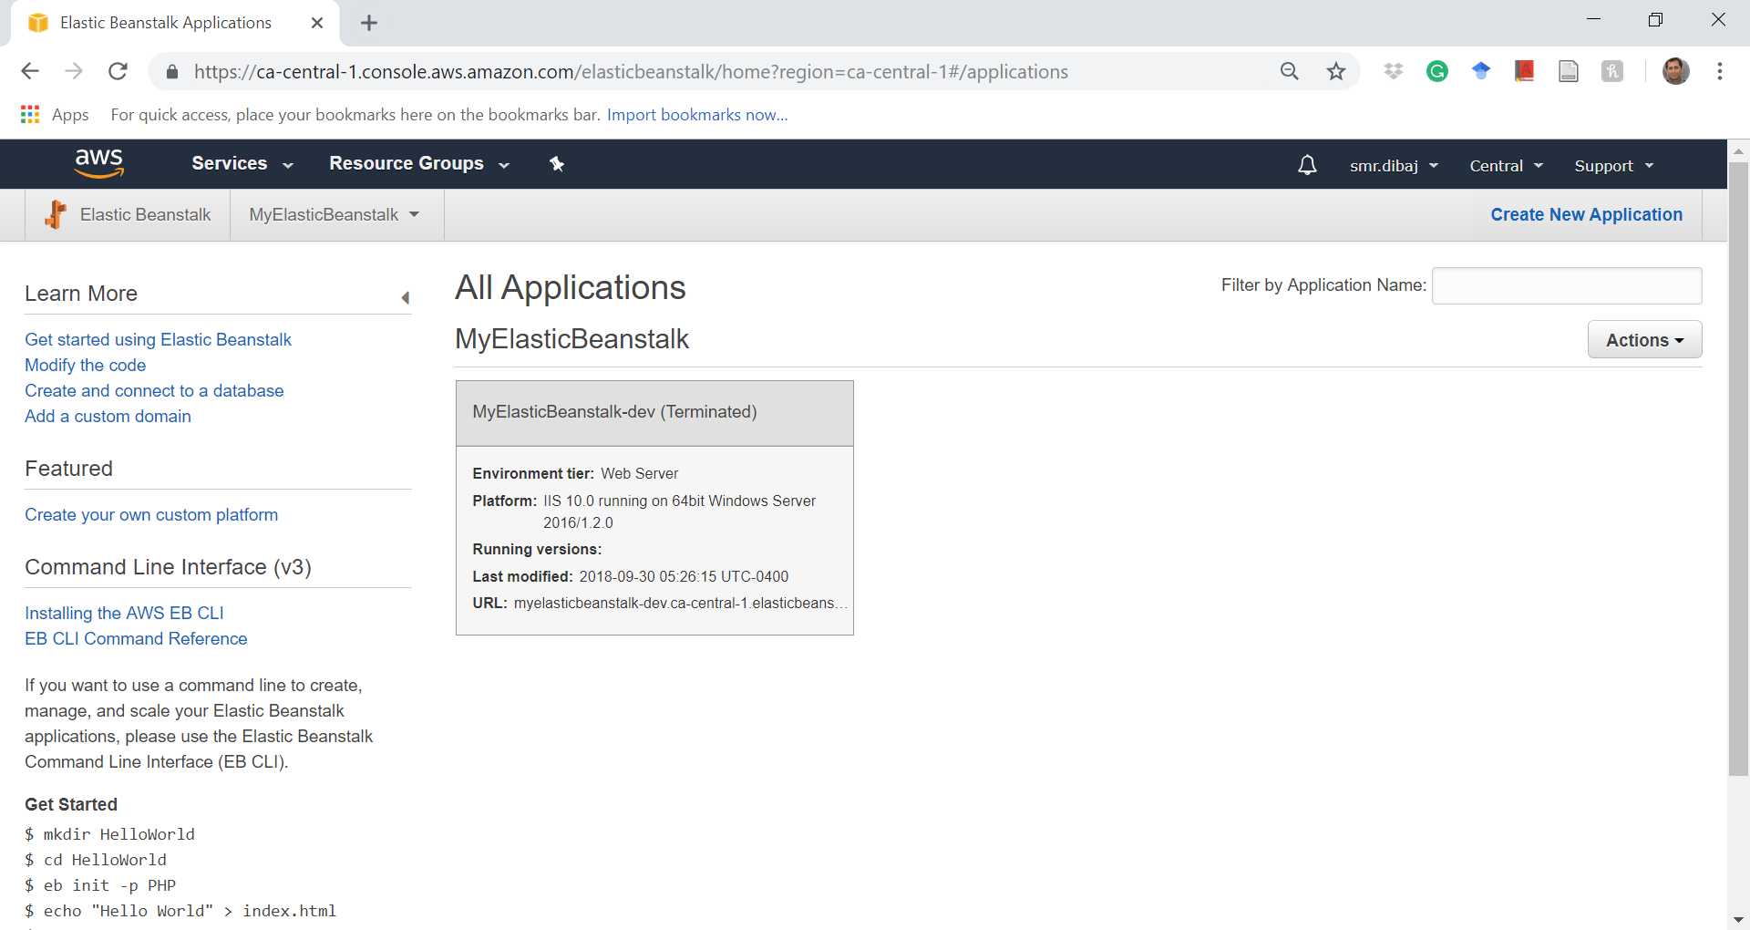
Deploy Web App to AWS Elastic Beanstalk
If you go to AWS Services → Compute → Elastic Beanstalk

Slide 40
References
https://docs.aws.amazon.com/toolkit-for-visual-studio/latest/user-guide/deployment-beanstalk-traditional.html
https://www.youtube.com/watch?v=NhsELnv28NU
https://docs.aws.amazon.com/elasticbeanstalk/latest/dg/concepts-webserver.html
https://www.nginx.com/resources/glossary/application-server-vs-web-server/
https://www.youtube.com/watch?v=96DJ2Og90hU

Slide 41
Thank you

